Slide 1

Weak values extraction from neutron interferograms
Ismaele Vincent Masiello

Slide 2
Content

Slide 3
Content
Part 1: Motivation and goal

Slide 4
Content
Part 1: Motivation and goal
Part 2: Introduction to weak values

Slide 5
Content
Part 1: Motivation and goal
Part 2: Introduction to weak values
Part 3: Weak values based description of a Mach-Zehnder interferometer

Slide 6
Content
Part 1: Motivation and goal
Part 2: Introduction to weak values
Part 3: Weak values based description of a Mach-Zehnder interferometer
Part 4: Experimental measurement of path weak values directly from interferograms

Slide 7
Part 1: Motivation and goal

Slide 8




Motivation
Mach-Zehnder:

Slide 9
Motivation
Mach-Zehnder:
Particle

Slide 10
Motivation
Mach-Zehnder:

Slide 11
Motivation
Mach-Zehnder:

Slide 12
Motivation
Mach-Zehnder:
Path superposition

Slide 13
Motivation
Mach-Zehnder:
Path superposition
2
1

Slide 14
Motivation
Mach-Zehnder:
2
1

Slide 15
Motivation
Mach-Zehnder:
Recombined paths
?
?

Slide 16
Motivation
Mach-Zehnder:
?
?

Slide 17
Motivation
Mach-Zehnder:
Interference!

Slide 18

Motivation
Mach-Zehnder:

Slide 19

Motivation
Mach-Zehnder:

Slide 20
Motivation
Mach-Zehnder:

Slide 21
Motivation
Mach-Zehnder:

Slide 22

Motivation
Mach-Zehnder:

Slide 23
Goal
Use weak values for a new perspective on interferometry and hopefully some new insight!

Slide 24
Part 2: Introduction to weak values

Slide 25


Weak value
Definition:

Slide 26
Weak value
Definition:

Slide 27
Weak value
Observable:
Pre-selected state:
Post-selected state:
Definition:

Slide 28

Weak value
Observable:
Pre-selected state:
Post-selected state:
Definition:
Expectation value:

Slide 29
Weak value
Observable:
Pre-selected state:
Post-selected state:
Not bounded by eigenvalues
Definition:
Expectation value:

Slide 30
Weak value
Observable:
Pre-selected state:
Post-selected state:
Not bounded by eigenvalues
Complex number
Definition:
Expectation value:

Slide 31

Weak value
Observable:
Pre-selected state:
Post-selected state:
Not bounded by eigenvalues
Complex number
Real
Imaginary

Slide 32
Weak value
Observable:
Pre-selected state:
Post-selected state:
Not bounded by eigenvalues
Complex number
Real
Imaginary
Describes the observable in the limit of minimal disturbance

Slide 33
Part 3: Weak values based description of interferometry

Slide 34

Standard interferometry formalism

Slide 35
Standard interferometry formalism

Slide 36
Standard interferometry formalism

Slide 37
Standard interferometry formalism

Slide 38

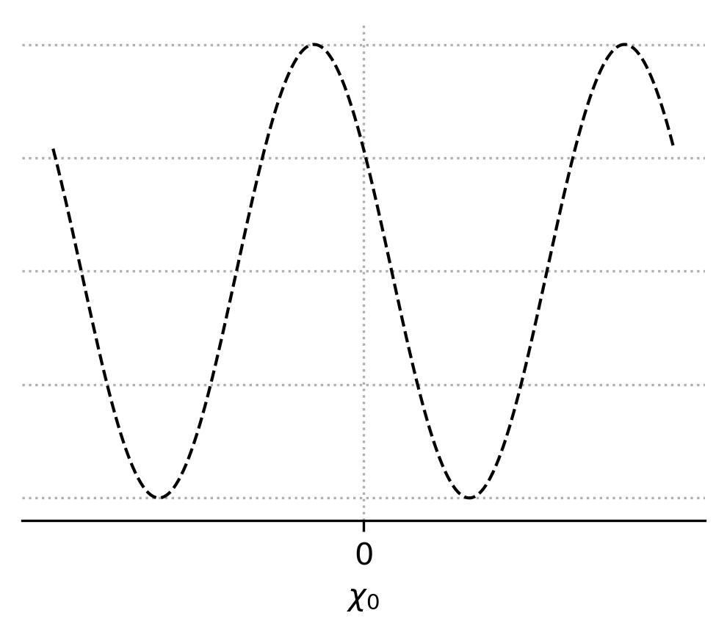
Standard interferometry formalism
Measured intensity

Slide 39
Standard interferometry formalism
Measured intensity
Interferogram

Slide 40
Weak value picture

Slide 41
Weak value picture
Pre-selection

Slide 42
Weak value picture
Pre-selection
Interaction

Slide 43

Weak value picture
Pre-selection
Interaction

Slide 44
Weak value picture
Pre-selection
Interaction
Post-selection

Slide 45
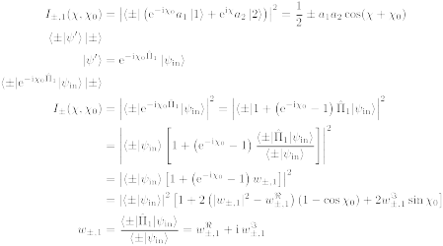
Weak value picture
Path weak value

Slide 46
Weak value picture
Measured intensity

Slide 47
Weak value picture
Measured intensity
Amplitude
square

Slide 48
Weak value picture
Measured intensity
Real part
Amplitude
square

Slide 49
Weak value picture
Measured intensity
Real part
Amplitude
square
Imaginary
part

Slide 50
Weak value picture
Measured intensity

Slide 51

Weak value picture
Measured intensity

Slide 52
Weak value picture
Measured intensity

Slide 53
Weak value picture
Measured intensity

Slide 54
Weak value picture
Almost there...

Slide 55
Weak value picture
Almost there...
Interferogram

Slide 56
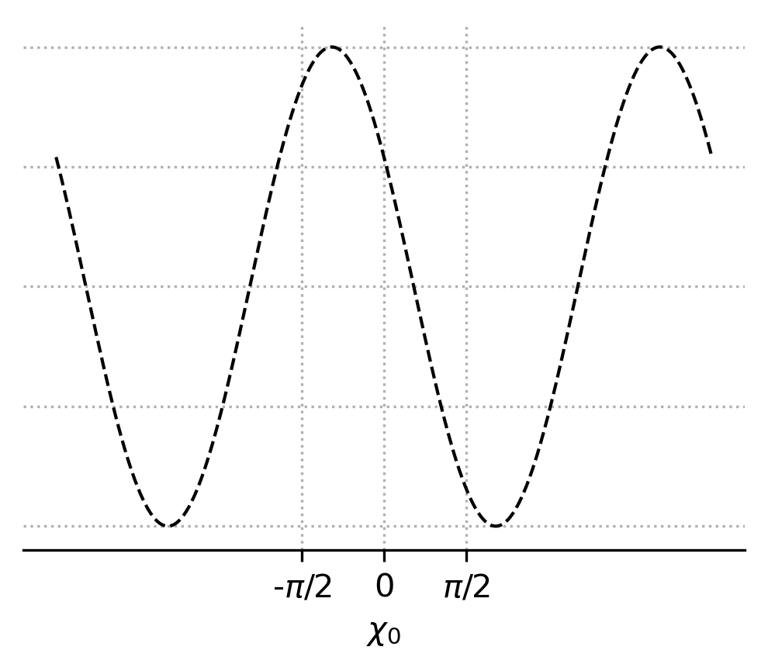
Weak value picture
Almost there...
Interferogram

Slide 57
Weak value picture
Almost there...
Interferogram

Slide 58
Weak value picture
Almost there...

Slide 59
Weak value picture
Almost there...

Slide 60
Weak value picture
Almost there...

Slide 61
Weak value picture
Almost there...
2nd order equation

Slide 62
Weak value picture
Almost there...
2nd order equation
2 solutions

Slide 63
Weak value picture
Almost there...

Slide 64

Weak value picture
Almost there...

Slide 65
Weak value picture
Path blocker

Slide 66

Weak value picture
Pre-selection
Interaction
Post-selection
Path blocker

Slide 67
Weak value picture
Measured intensity

Slide 68
Weak value picture
Measured intensity

Slide 69
Weak value picture
Measured intensity

Slide 70
Weak value picture
We got there!

Slide 71
Part 4: Experimental measurement of path weak value from interferograms

Slide 72

Neutron interferometer

Slide 73
Setup

Slide 74
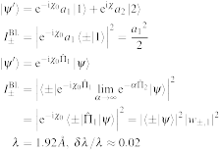
Setup
Unpolarised
neutron beam
1
1

Slide 75
Setup
Unpolarised
neutron beam
1
2
Neutron
interferometer
2
1

Slide 76
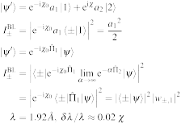
Setup
Unpolarised
neutron beam
1
2
Neutron
interferometer
2
1
Phase-shifter
3
3

Slide 77
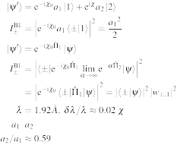
Setup
Unpolarised
neutron beam
1
2
Neutron
interferometer
2
1
4
Phase-shifter
3
3
Indium foils
to adjust path
amplitudes
4

Slide 78
Setup
Unpolarised
neutron beam
1
5
2
Neutron
interferometer
2
1
4
Phase-shifter
3
3
Indium foils
to adjust path
amplitudes
4
Cadmium
path blocker
5

Slide 79
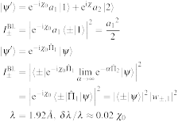
Setup
Unpolarised
neutron beam
1
5
2
Neutron
interferometer
2
1
4
Phase-shifter
3
3
6
Indium foils
to adjust path
amplitudes
4
Cadmium
path blocker
Phase-shifter
5
6

Slide 80
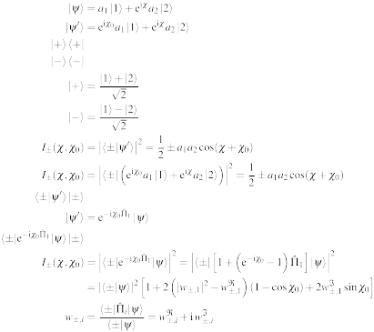
Setup
Unpolarised
neutron beam
1
5
2
Neutron
interferometer
2
1
4
7
Phase-shifter
3
3
6
Indium foils
to adjust path
amplitudes
8
4
Cadmium
path blocker
Phase-shifter
-detector
5
6
-detector
7
8

Slide 81
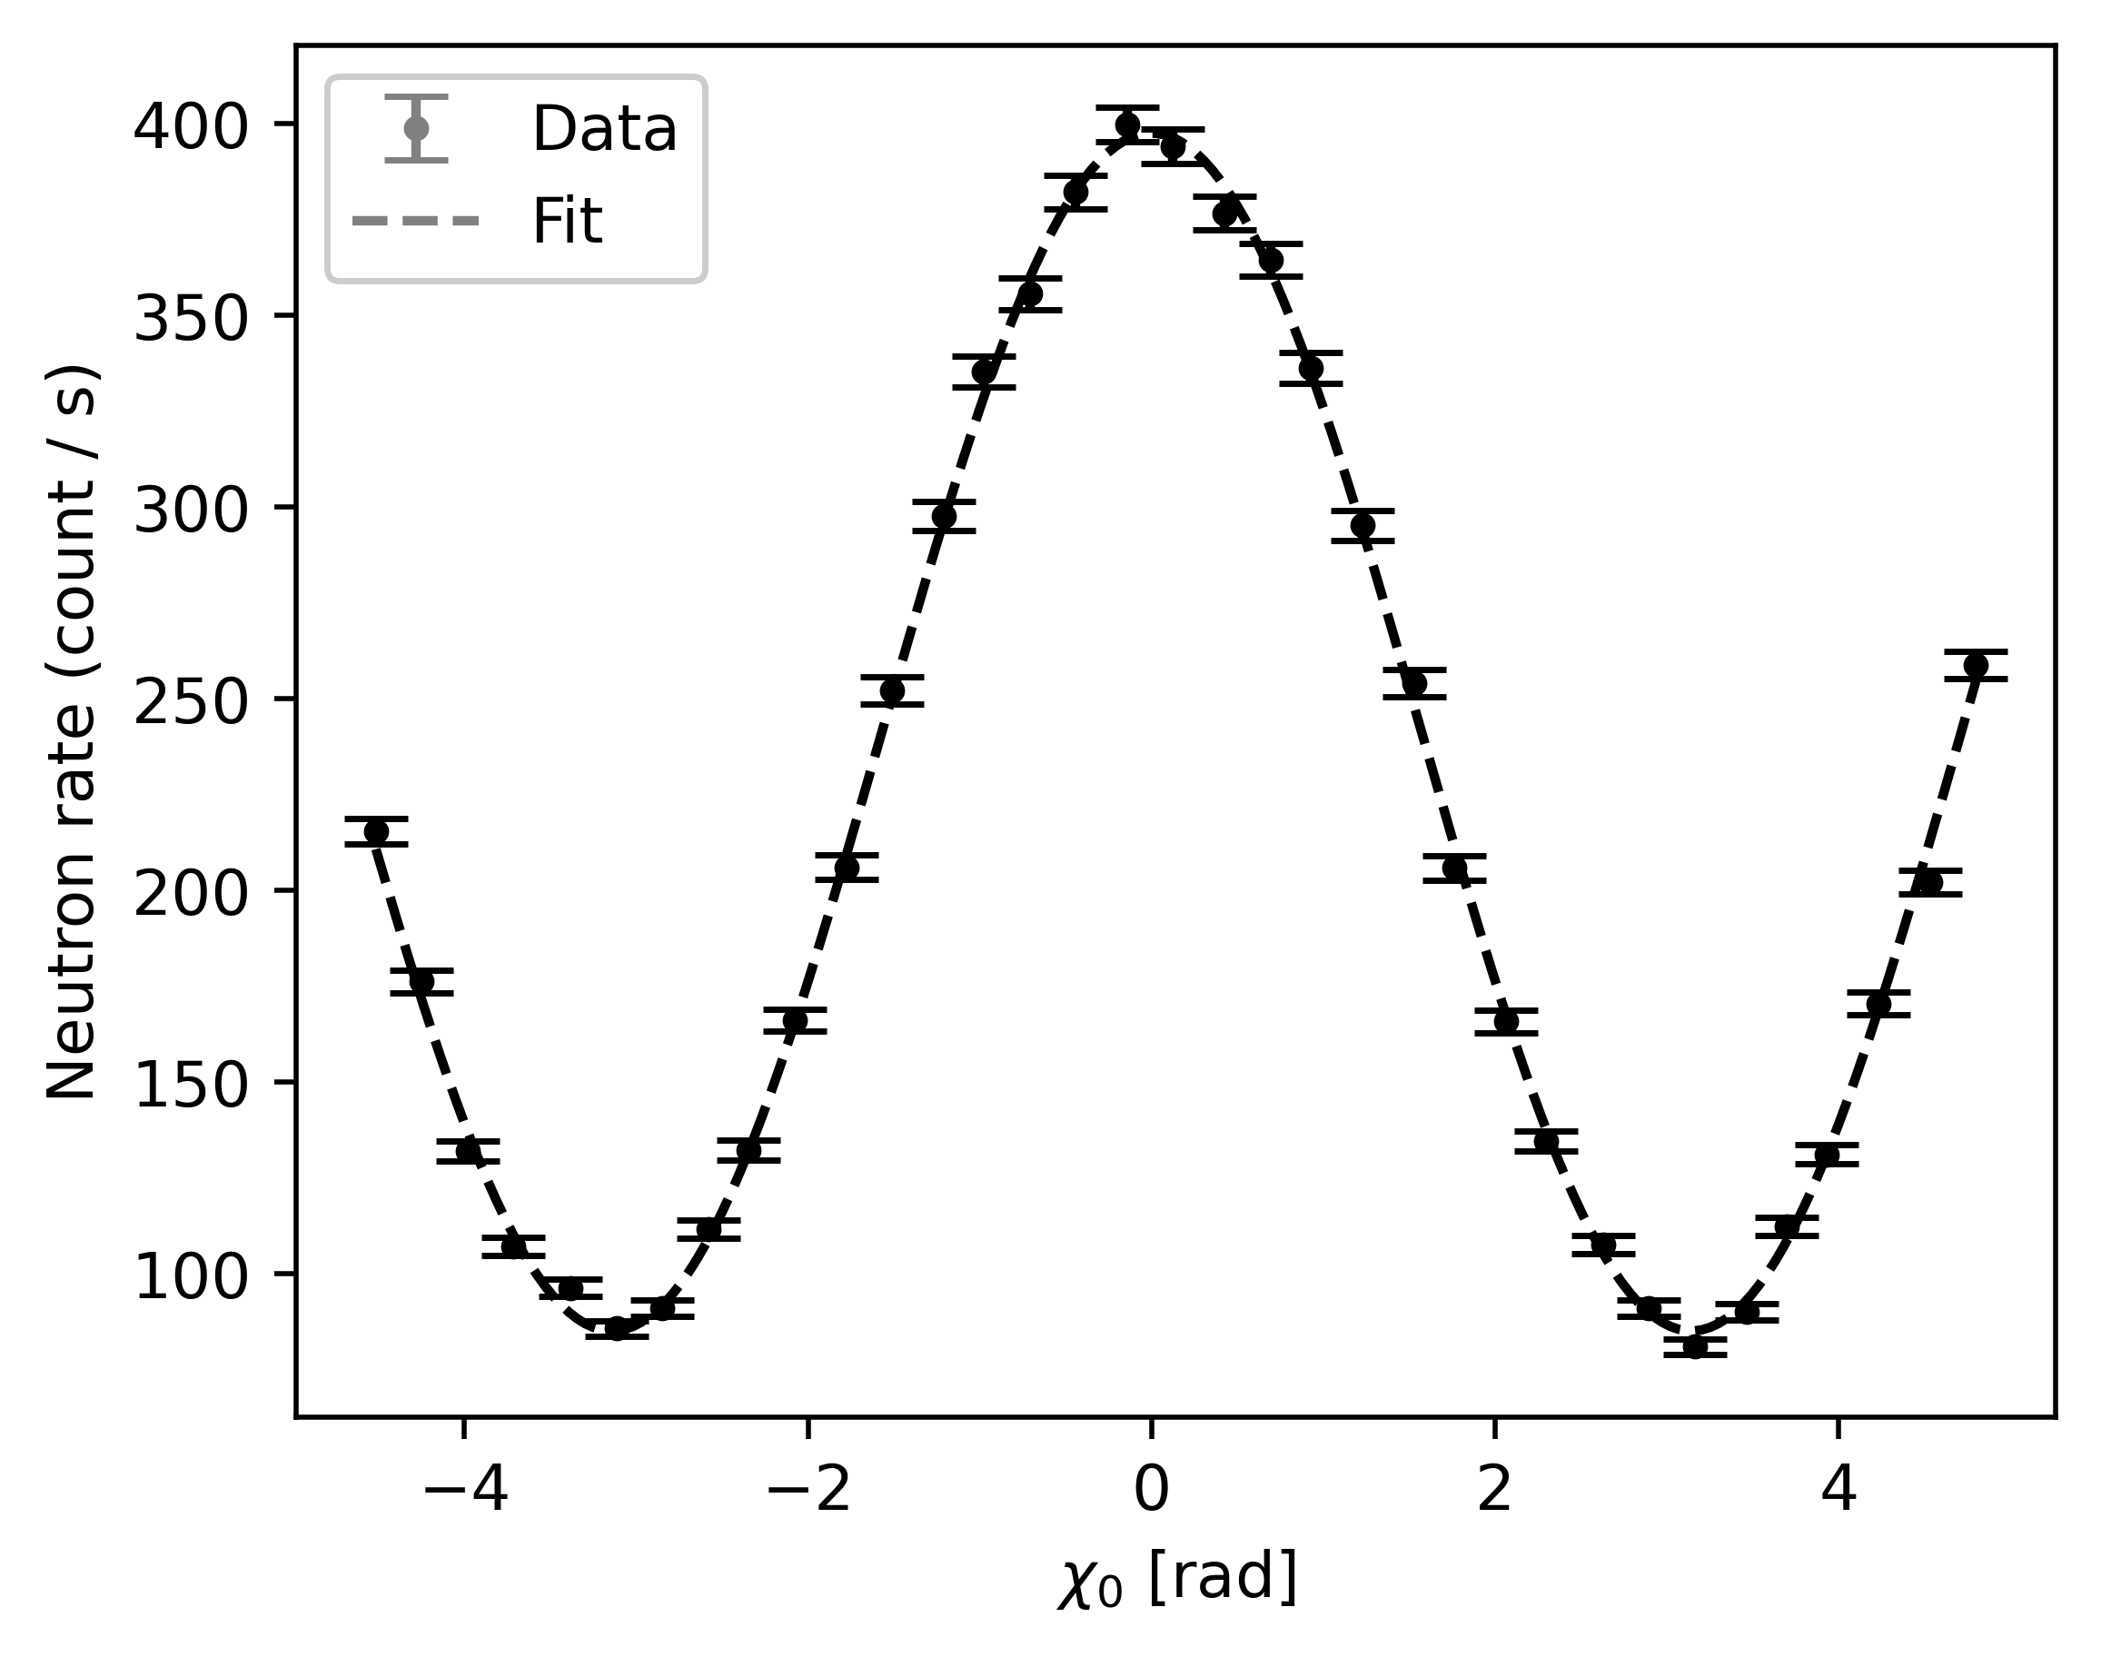
Example of interferogram

Slide 82
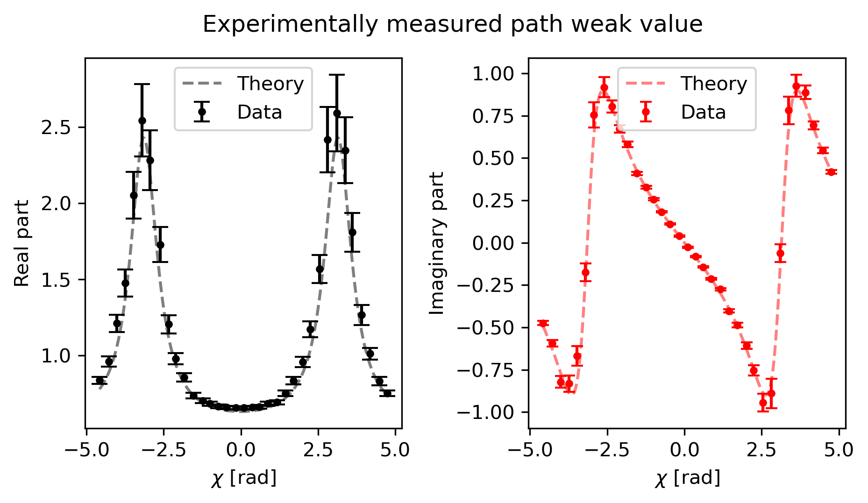
Results: Weak value of path 1

Slide 83
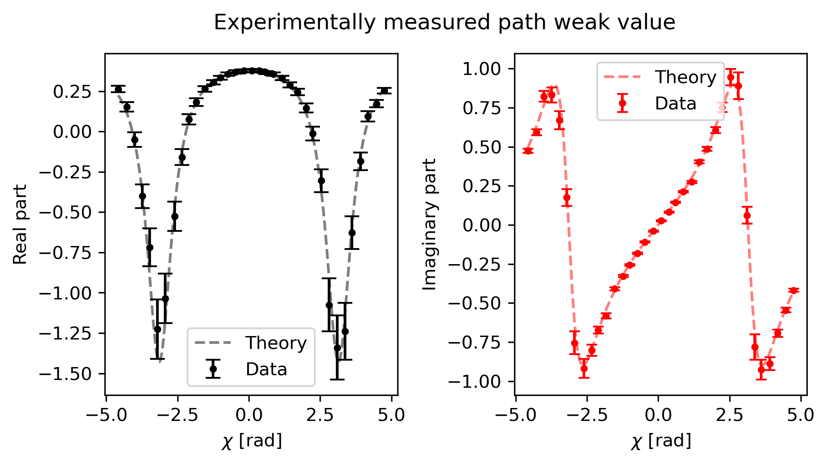
Results: Weak value of path 2

Slide 84
Interpretation of the results

Slide 85

Interpretation of the results

Slide 86


Aknowledgements
I. V. Masiello¹, A. Dvorak¹, H. Lemmel^{1,2}, and Y. Hasegawa^{1,3}
¹Atominstitut, TU Wien, Stadionallee 2, 1020 Vienna, Austria
²Institut Laue-Langevin, 71 avenue des Martyrs, 38000 Grenoble, France
³Department of Applied Physics, Hokkaido University, Kita-ku, Sapporo 060-8628, Japan

Slide 87
Thanks for your time!

